Slide 1
Septic System Installation Slide Show
In 1994, The Buzzards Bay NEP modified a computer slide show developed by Purdue University for the US EPA so that the information presented better reflects to conditions and permitting in Massachusetts. The Project distributed this slide show to area Boards of Health and other interested parties. We have placed this slide show on our web site so more people can appreciate and better understand septic system siting requirements in Massachusetts.

Slide 2
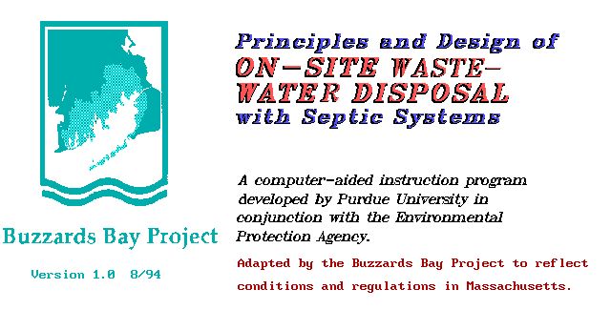
Septic System Installation Slide Show

Slide 3
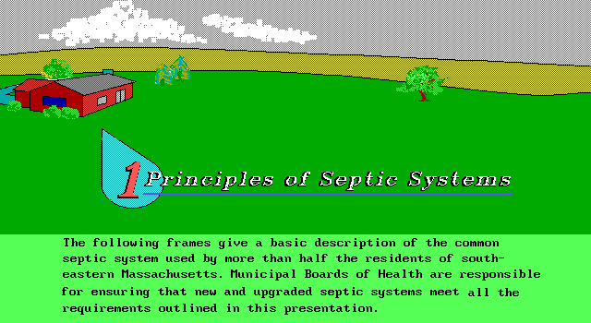
Septic System Installation Slide Show

Slide 4
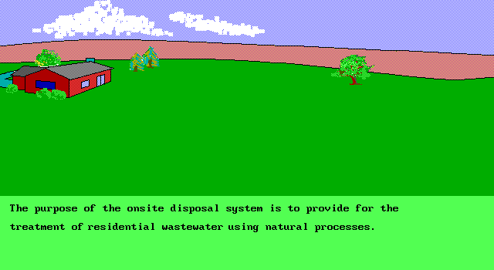
Septic System Installation Slide Show

Slide 5
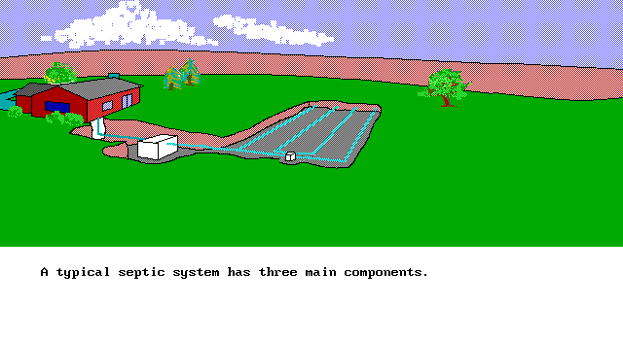
Septic System Installation Slide Show

Slide 6
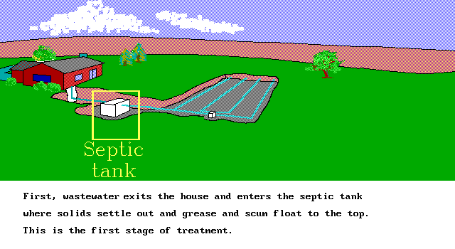
Septic System Installation Slide Show

Slide 7
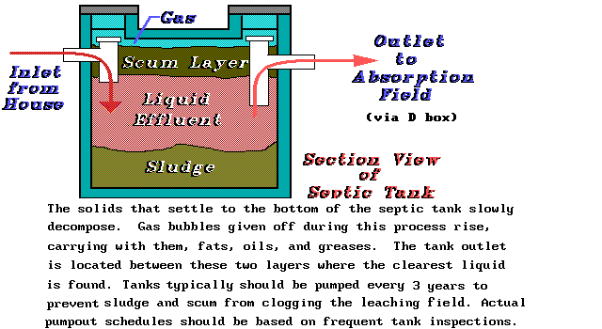
Septic System Installation Slide Show

Slide 8
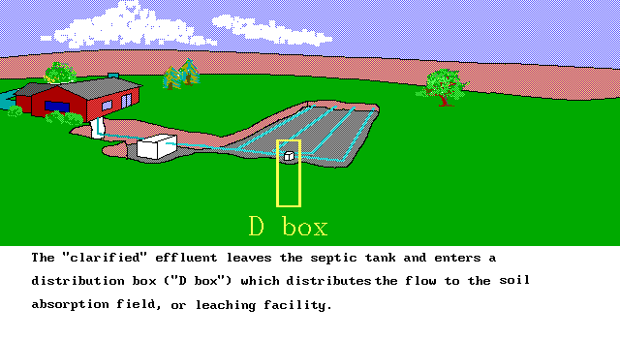
Septic System Installation Slide Show

Slide 9
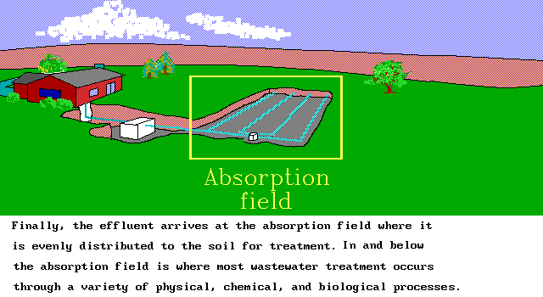
Septic System Installation Slide Show

Slide 10
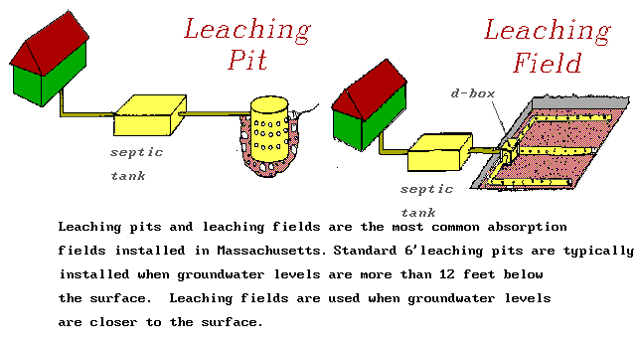
Septic System Installation Slide Show

Slide 11
Septic System Installation Slide Show

Slide 12
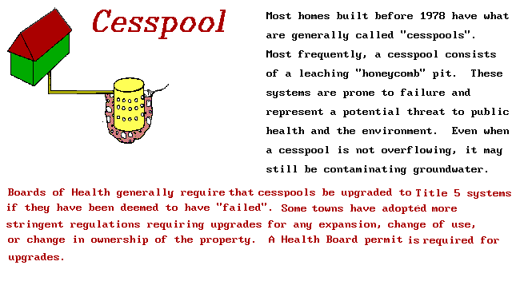
Septic System Installation Slide Show

Slide 13
Septic System Installation Slide Show

Slide 14
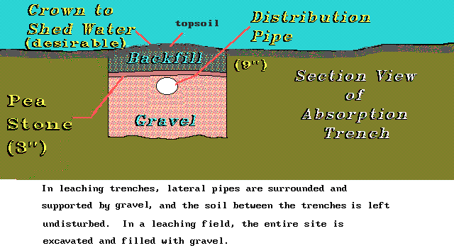
Septic System Installation Slide Show

Slide 15
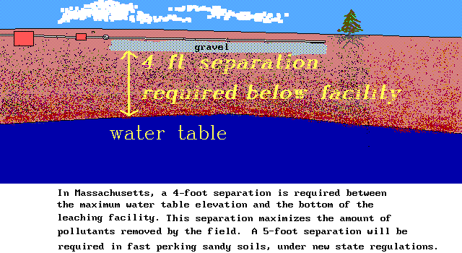
Septic System Installation Slide Show

Slide 16
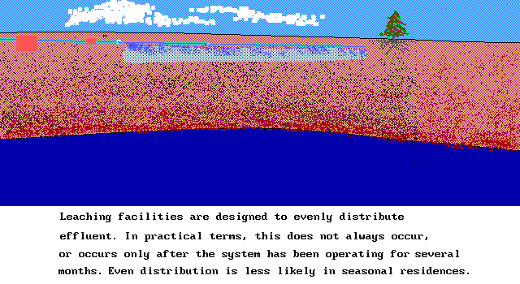
Septic System Installation Slide Show

Slide 17
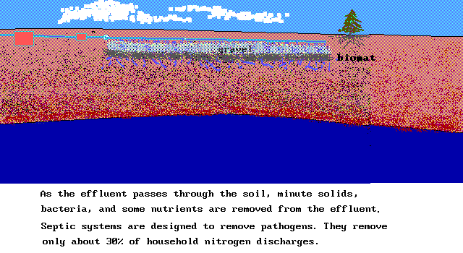
Septic System Installation Slide Show

Slide 18
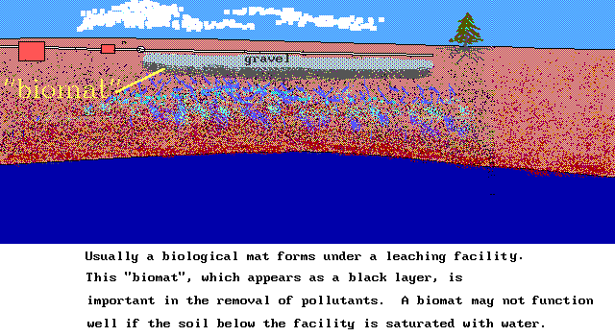
Septic System Installation Slide Show

Slide 19
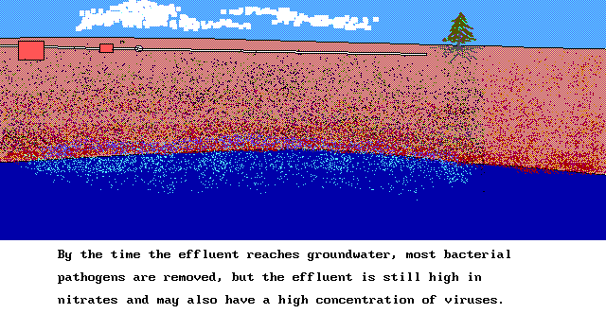
Septic System Installation Slide Show

Slide 20
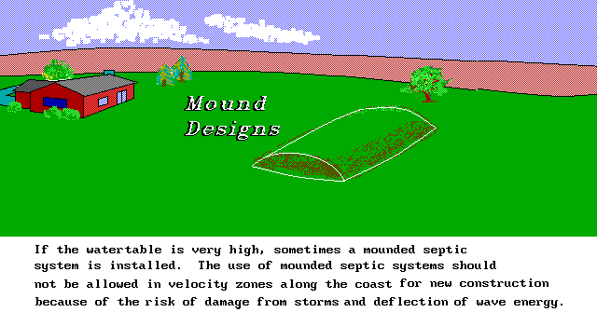
Septic System Installation Slide Show

Slide 21
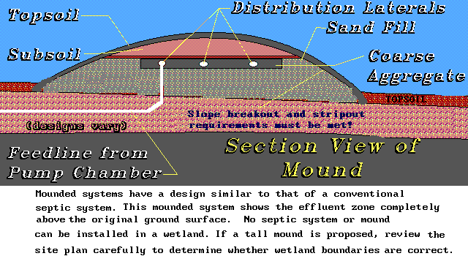
Septic System Installation Slide Show

Slide 22
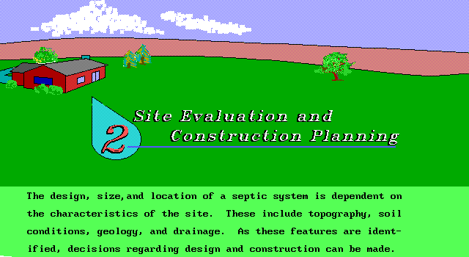
Septic System Installation Slide Show

Slide 23
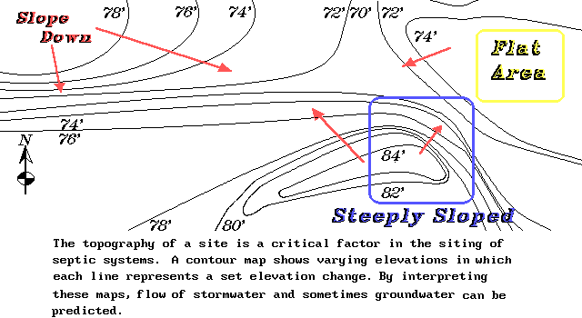
Septic System Installation Slide Show

Slide 24
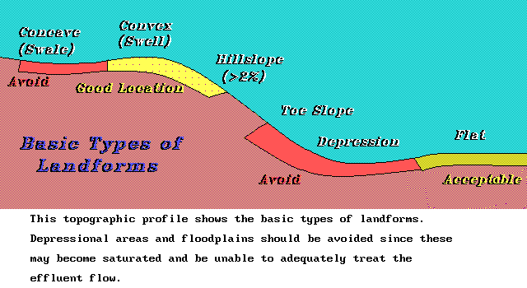
Septic System Installation Slide Show

Slide 25
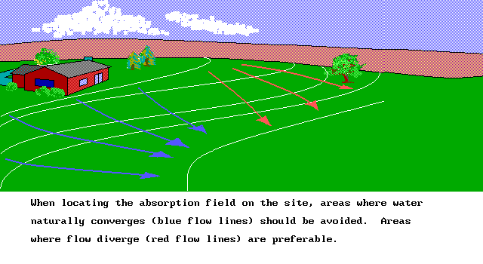
Septic System Installation Slide Show

Slide 26
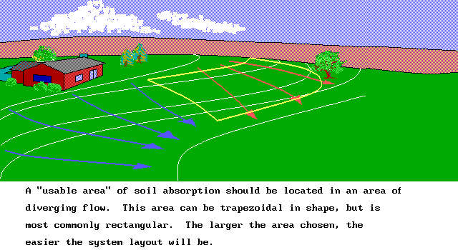
Septic System Installation Slide Show

Slide 27
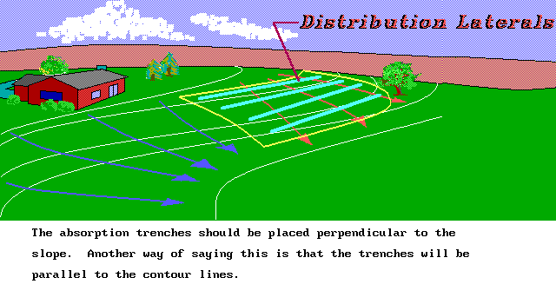
Septic System Installation Slide Show

Slide 28
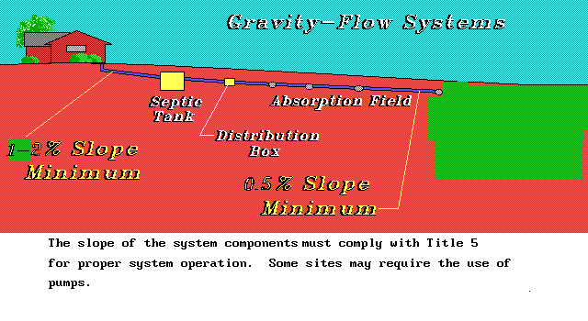
Septic System Installation Slide Show

Slide 29
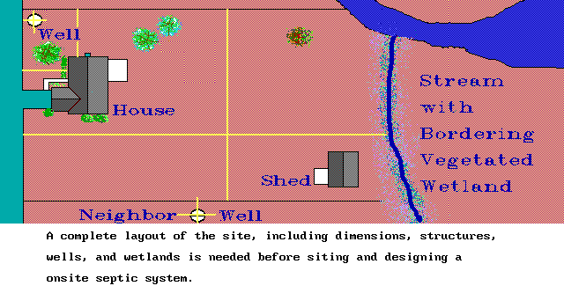
Septic System Installation Slide Show

Slide 30
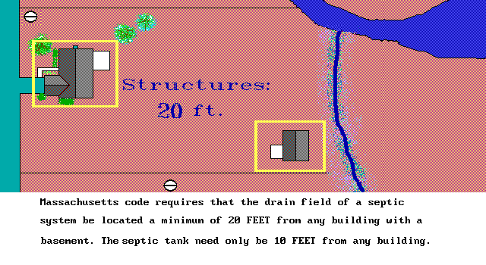
Septic System Installation Slide Show

Slide 31
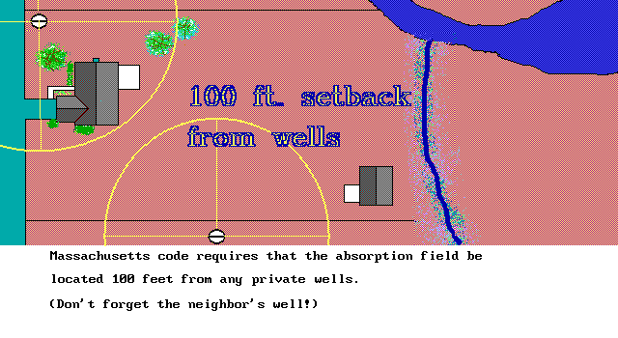
Septic System Installation Slide Show

Slide 32
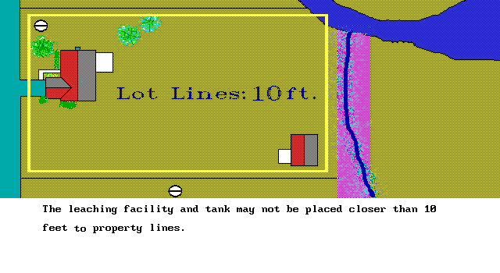
Septic System Installation Slide Show

Slide 33
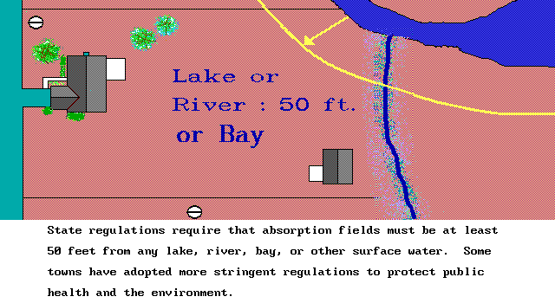
Septic System Installation Slide Show

Slide 34
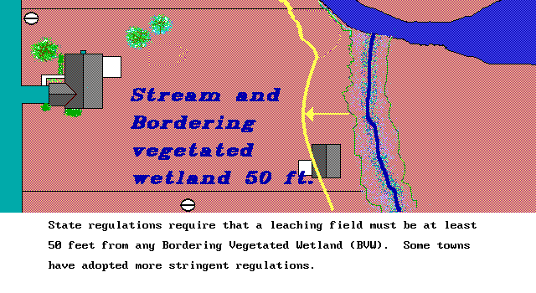
Septic System Installation Slide Show

Slide 35
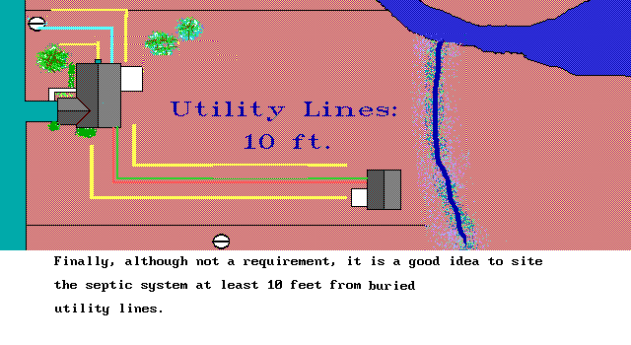
Septic System Installation Slide Show

Slide 36
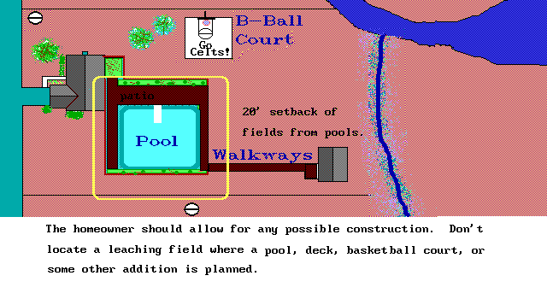
Septic System Installation Slide Show

Slide 37
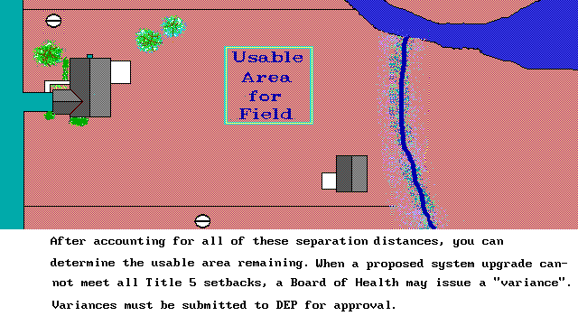
Septic System Installation Slide Show

Slide 38
Septic System Installation Slide Show

Slide 39
Septic System Installation Slide Show

Slide 40
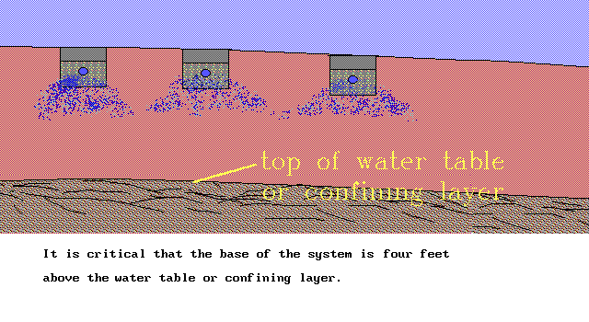
Septic System Installation Slide Show

Slide 41
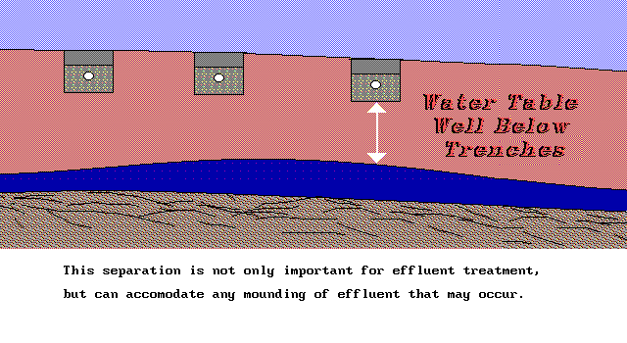
Septic System Installation Slide Show

Slide 42
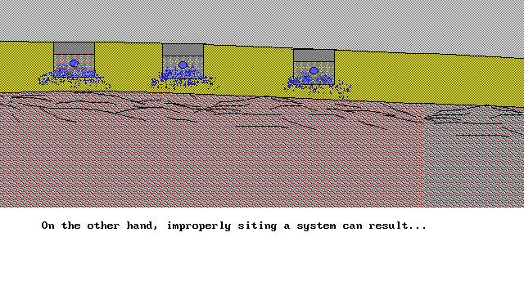
Septic System Installation Slide Show

Slide 43
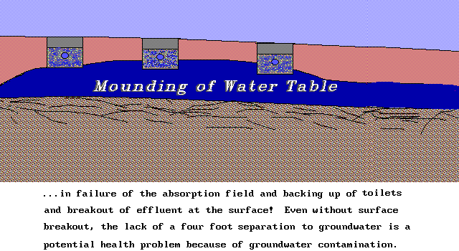
Septic System Installation Slide Show

Slide 44
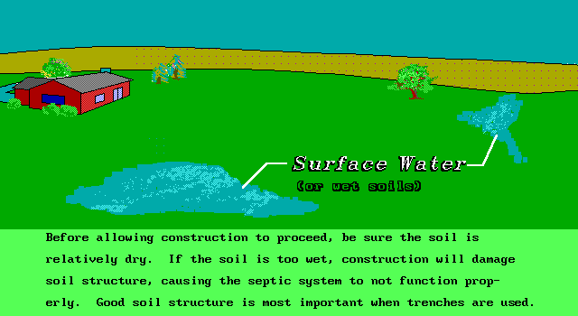
Septic System Installation Slide Show

Slide 45
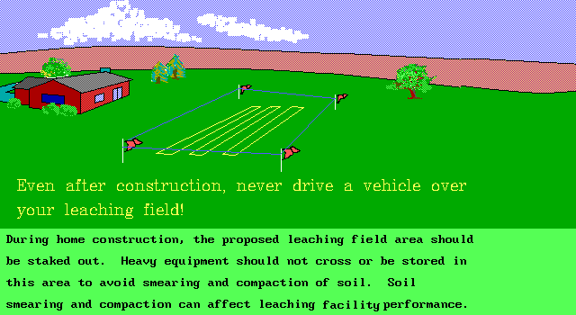
Septic System Installation Slide Show

Slide 46
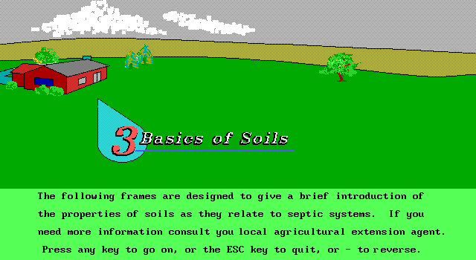
Septic System Installation Slide Show

Slide 47
Septic System Installation Slide Show

Slide 48
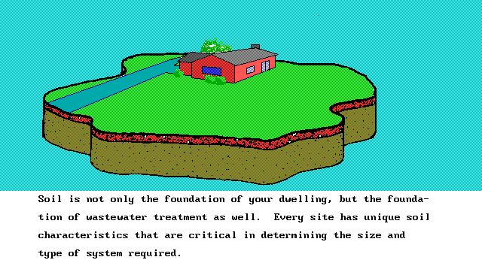
Septic System Installation Slide Show

Slide 49
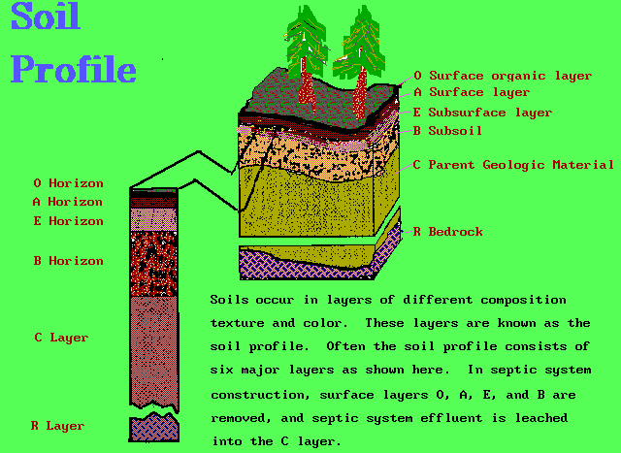
Septic System Installation Slide Show

Slide 50
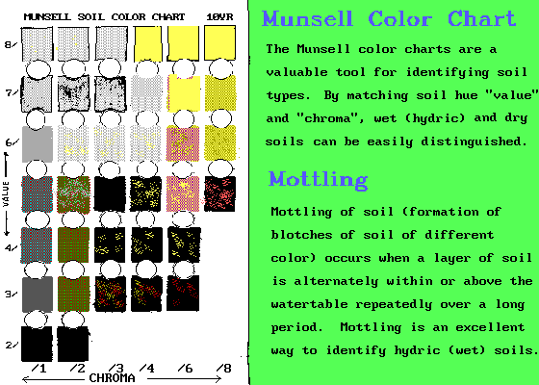
Septic System Installation Slide Show

Slide 51
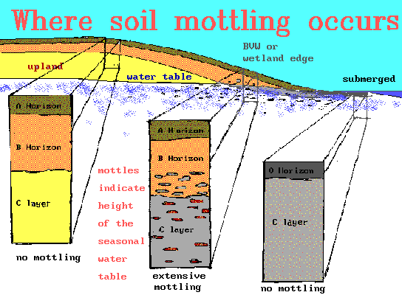
Septic System Installation Slide Show

Slide 52
Septic System Installation Slide Show

Slide 53
Septic System Installation Slide Show

Slide 54
Septic System Installation Slide Show

Slide 55
Septic System Installation Slide Show

Slide 56
Septic System Installation Slide Show

Slide 57
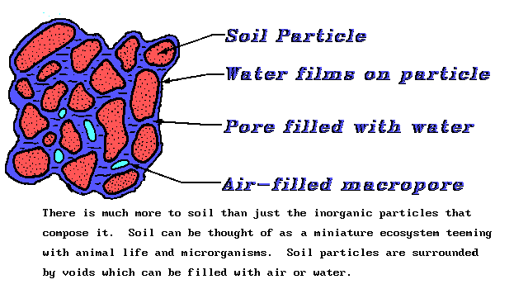
Septic System Installation Slide Show

Slide 58
Septic System Installation Slide Show

Slide 59
Septic System Installation Slide Show

Slide 60
Septic System Installation Slide Show

Slide 61
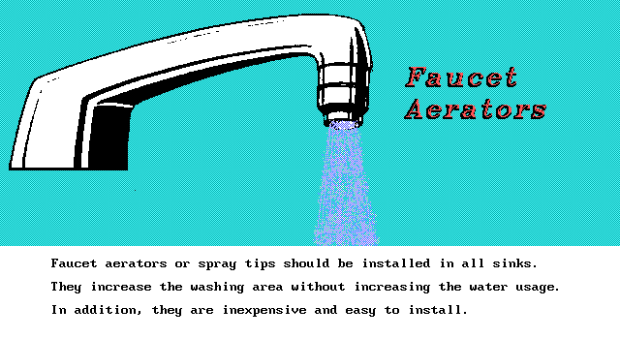
Septic System Installation Slide Show

Slide 62
Septic System Installation Slide Show

Slide 63
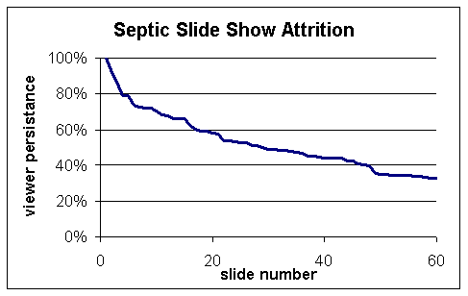
Septic System Installation Slide Show
Congratulations! You are among the top 1/3 of slide show viewers that stuck it out to the end.

